Slide 1
Model-Informed Drug Development and Dose Optimization Planning
Boston Regulatory Affairs Group
20 June 2024

Slide 2
Outline
Drug development
Models
MIDD
Dose optimization
Small print - Opinions are my own and not meant to represent those of Vivpro

Slide 3
Drug development
Begin with the end in mind
Indication
What is the unmet medical need?
Who are the patients that need treatment?
Medication
What is the evidence that it may be active against disease of interest?
How much medicine is needed?
How will it be administered?

Slide 4
Drug development in ancient times
Before 1962
1938 – FFDCA – increased authority of FDA to monitor drugs
Evidence of safety and quality were required
FDA had 180 days to reject, but could extend review time if NDA incomplete
thalidomide – Oct 1957 – expansion of marketing; 1960 – FDA application
1959 – congressional hearings to better understand evidence of efficacy
Kefauver-Harris 1962
Demonstration of safety and efficacy required

Slide 5
Lasix (furosemide, frusemide)
2023 ~ 20th (35th?) most prescribed medicine in US and UK
Patented in 1959, approved in 1964
Approved for treatment of edema, hypertension
Current (2010) USPI has no clinical trials section
Clinical studies
none described in 2010 USPI
safety and clinical information appear to have been added from post approval experiences
Pharmacokinetic studies
Absolute bioavailability study
Geriatric PK study
No models mentioned

Slide 6
Lipitor (atorvastatin)
2023 most frequently prescribed medicine in US and UK
Patented in 1986, approved in 1996
Approved for prevention of MI, along with diet to decrease LDL-C
Section 14 - Clinical Trials section includes descriptions
Clinical studies
17 placebo-controlled studies mentioned for safety
7 or 8 clinical trials mentioned for efficacy
Pharmacokinetic studies
Absolute bioavailability
Food-fast
24 DDI
Special population (geriatrics, pediatrics, hepatic impairment, renal impairment)
Population pk model mentioned for in pediatric PK

Slide 7
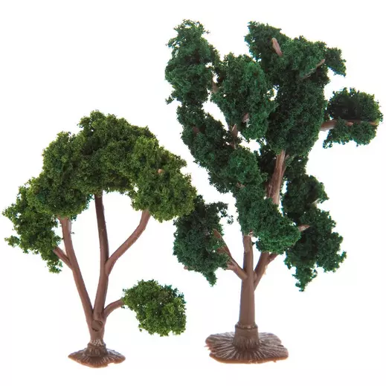
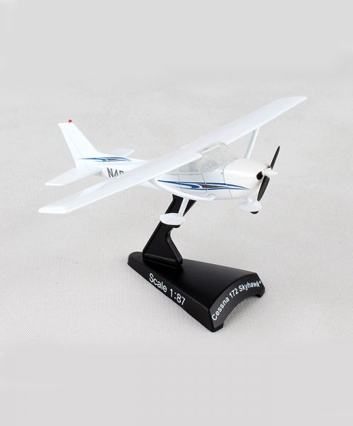
Models
a 3-dimensional representation, typically on a small scale than the original
an abstract description of a concrete system using mathematical concepts and language

Slide 8
Remembering an oldie…. Y=mx+b
Score on exam = 4.6 x hrs study + 52
Model permits predictions of responses for conditions not measured
Source: Mathbitsnotebook.com

Slide 9
Modeling and simulation
Collect data
Fit a model to data (verify, evaluate, validate)
Use model for simulation of conditions not studied
Interpolation (conditions within the range studied)
Extrapolation (conditions outside the range studied)
Every simulation is (usually) supported by a model

Slide 10
(some of the) Models used in drug development
Formulation/Manufacturing
Dissolution
Stability
Nonclinical/Clinical
(population) Pharmacokinetic
Pharmacokinetic-pharmacodynamic (PKPD)
Exposure-response
Physiologically based pharmacokinetic (PBPK)
Quantitative systems pharmacology
Drug-disease trials
And so on….

Slide 11
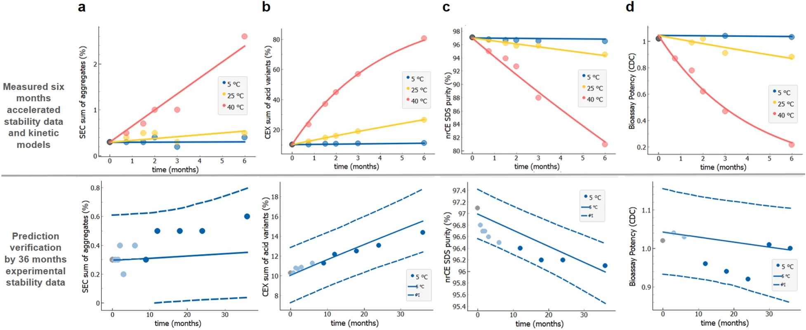
Stability Models
Kuzman et al. Scientific Reports 2021 11

Slide 12
Pharmacokinetic Models
Magallanes et al Curr Topic Pharmacol 2016
Zhang et al ACOP 2022

Slide 13
Utility of Models
Better understanding of ….
Better study design
More efficient drug development
Drug – optimal storage, stability conditions, best dose
Patients – exposure response, interpersonal variability
Observations – efficacy, tolerability, safety

Slide 14
Challenges with models
Prerequisites to models
Data
Time for analysis, modeling, validation
Interpretation (team, senior leadership, others)
Documentation
Regulatory assessment
Knowledge sharing
Package inserts
Publications

Slide 15
Model-informed drug development
Organized framework to support use of various models throughout drug development
Regulatory guidances (FDA, EMA, ICH)
ICH M15 – anticipated by 2025
FDA – 2018 – 2022 pilot of MIDD paired meeting program
FDA MIDD paired meeting program
Pilot results
Population pk, exposure response, PK/PD
Oncology and neurology most common of 14 therapeutic areas participating
Renewed in 2023
Quarterly applications accepted
Focus areas: dose selection, clinical trial simulation, predictive/mechanistic safety evaluation

Slide 16
MIDD Good Practices
(Clinical) development plan
Define target product profile (global?)
Describe studies needed to populate product profile (including pre-requisite studies)
Discuss with senior company leadership and regulatory authorities
MIDD development plan
Identify opportunities to incorporate models in development plan
Describe modeling activities to support registration
Discuss with senior company leadership and regulatory authorities
Incorporate ‘check-points’ to revisit initial assumptions and results

Slide 17
Dose optimization
Source: McCallum et al. in Padmanabham ed Handbook of Pharmacogenomic and Stratified Medicine 2014

Slide 18
Dose optimization
Key questions
How are safety/tolerability and efficacy defined?
What doses (concentrations) are associated with safety/tolerability and efficacy?
Nonclinical
Biomarkers
Drug concentration measurements
Translate nonclinical -> clinical simulations
Clinical
Phase 1 – healthy volunteers, patients
Phase 2 – patients
Phase 3 – patients – more limited dose

Slide 19
What has changed since ancient history?
Placebo-controlled trials
Active comparator trials
Dose to maximum tolerated dose
Patient outcome studies
Systematic review of all information
FDA Jan 2023 – Optimizing the Dosage of Human Prescription Drugs and Biological Products for Treatment of Oncologic Diseases

Slide 20
Preparation for MIDD Paired Meetings (or Clinical Pharmacology Dose Meeting)
Request (goal to obtain specific feedback on MIDD approach to question of interest)
Paired strategies (chronological, deep dive, different topics)
Background Document
Not a ‘core dump’
Relevant information, thoughtfully summarized
Oncology Dosing Tool Kit
Translational evidence
PK characteristics
Safety
Efficacy
Dose- and exposure response

Slide 21
In summary
Dose optimization in patients is the ultimate goal of drug development
Development plans, including planned modeling activity, facilitate clear communication of assumptions, key milestones and timelines
MIDD (quality, nonclinical, clinical, marketing, real world evidence) offers a boost to efficiency of development

Slide 22
Additional reading
Lalonde et al. Clin Pharm Ther 2007. Model-based drug development.
Marshall et al. Clin Pharm Ther 2016. Good practices in model-informed drug discovery and development: Practice, application and documentation.
Galluppi et al. Clin Pharm Ther 2024. Preparing for the FDA Model-Informed Drug Development (MIDD) Paired Meeting Program.
Madabushi R et al. Clin Pharm Ther 2024. The US Food and Drug Administration’s model-informed drug development meeting program: From Pilot to Pathway.

Slide 23
Thank You
Email Address:
sales@vivpro.ai

Slide 24
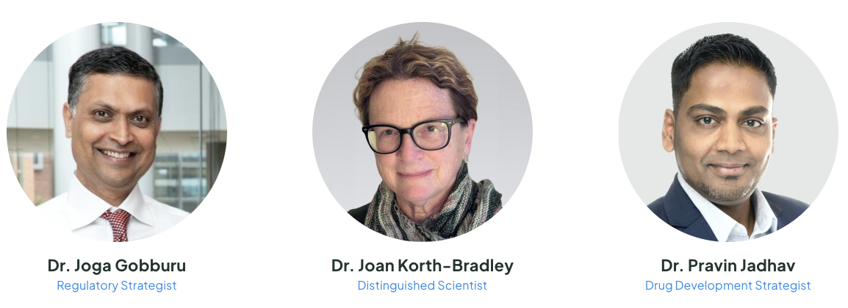
Introducing Vivpro

